Slide 1

Chapter 3
Introduction to Physical Layer

Slide 2
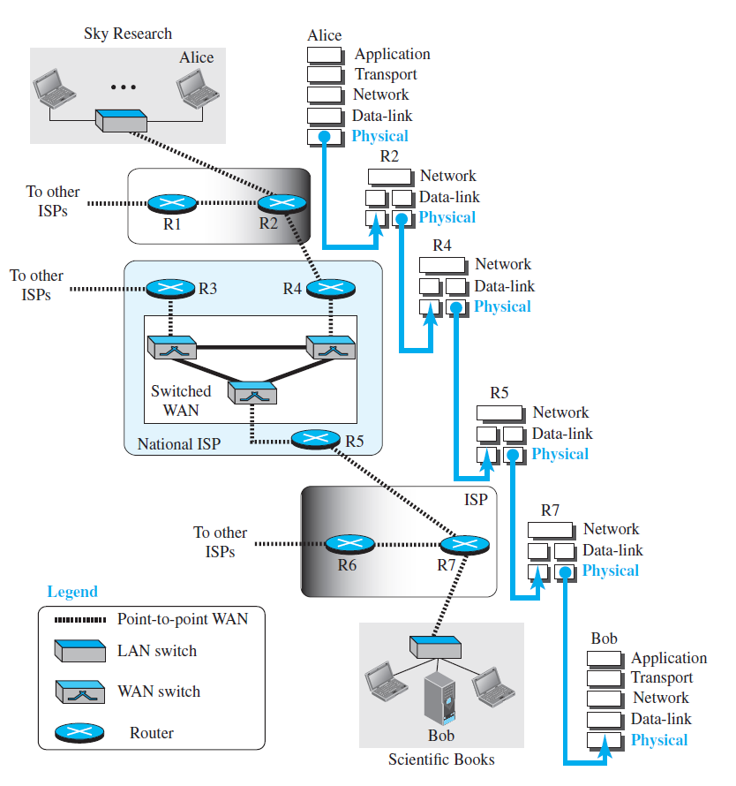
Figure 3.1 Communication at the physical layer

Slide 3
3.1.1 ANALOG AND DIGITAL DATA
Data can be analog or digital. The term analog data refers to information that is continuous; digital data refers to information that has discrete states. Analog data take on continuous values. Digital data take on discrete values.

Slide 4

Note
Data can be analog or digital. Analog data are continuous and take continuous values.
Digital data have discrete states and take discrete values.

Slide 5
3.1.2 ANALOG AND DIGITAL SIGNALS
Note
Signals can be analog or digital. Analog signals can have an infinite number of values in a range; digital signals can have only a limited number of values.

Slide 6
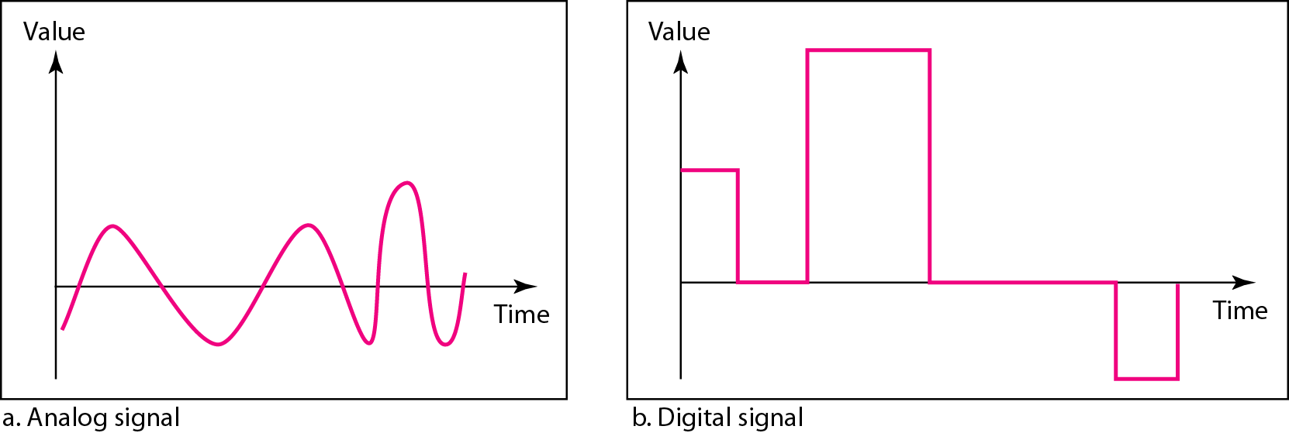
Figure 3.3 Comparison of analog and digital signals

Slide 7
3.1.3 PERIODIC & NONPERIODIC
Periodic signal
completes a pattern, and
repeats that pattern.
The completion of one full pattern is called a cycle.
Nonperiodic (aperiodic) signal
changes without exhibiting a pattern

Slide 8
Note
In data communications, we commonly use periodic analog signals and nonperiodic digital signals.

Slide 9
3.2 PERIODIC ANALOG SIGNALS
Periodic analog signals can be classified as simple or composite. A simple periodic analog signal, a sine wave, cannot be decomposed into simpler signals. A composite
periodic analog signal is composed of multiple sine waves.
Topics discussed in this section:
Sine Wave Wavelength Time and Frequency Domain Composite Signals
Bandwidth

Slide 10
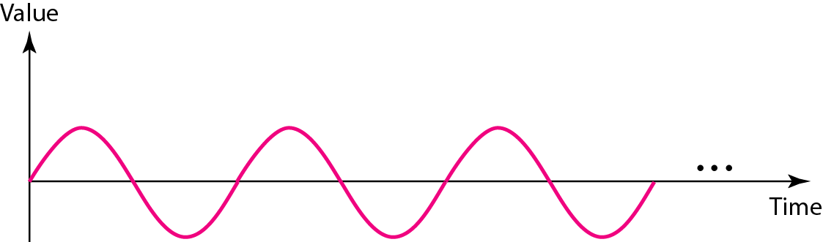
Figure 3.2 A sine wave

Slide 11
Peak Amplitude, Frequency and Phase
Peak amplitude - absolute value of the signal highest intensity, proportional to the energy it carries
Frequency - the number of cycles in 1 s.
Phase - position of the waveform relative to time 0.

Slide 12
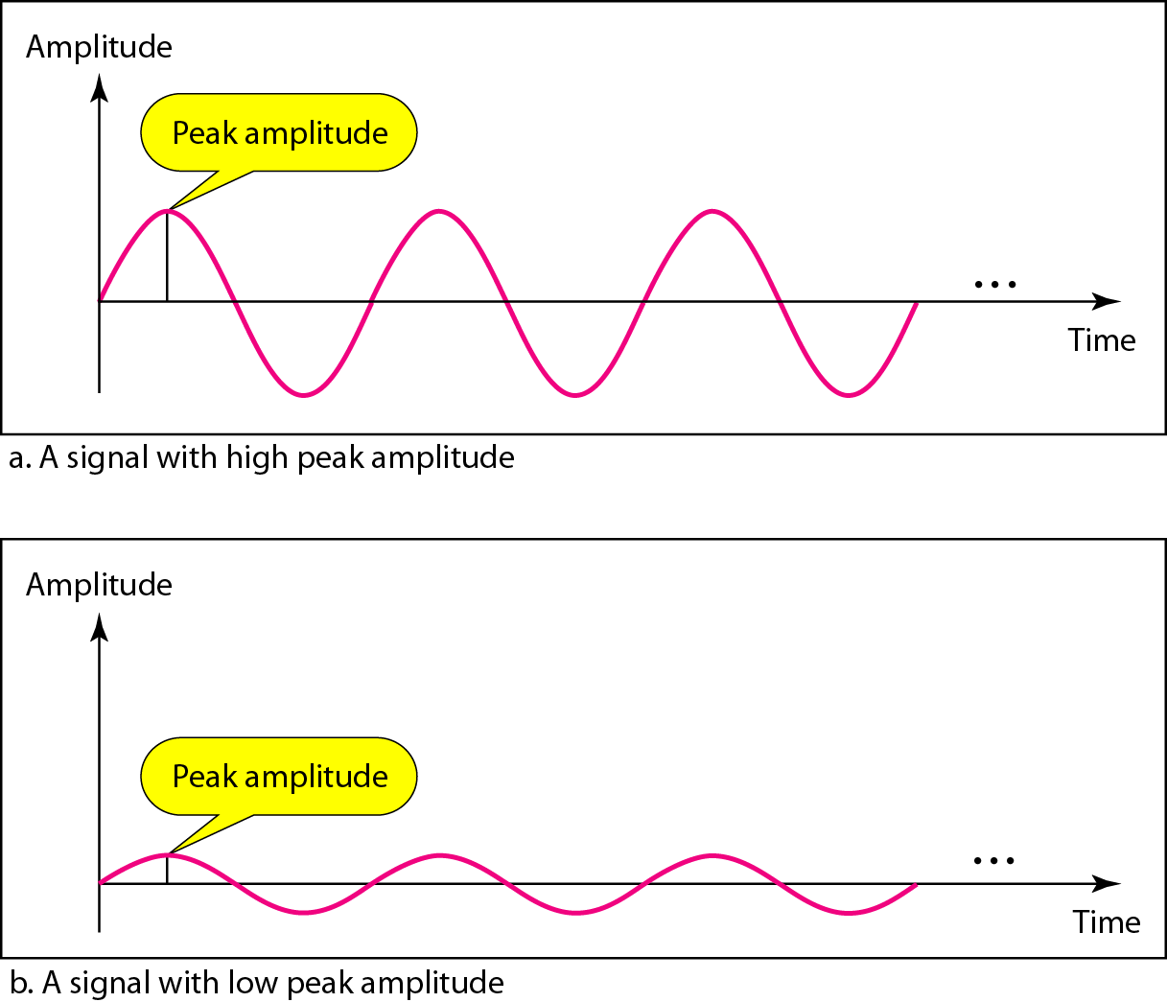
Figure 3.4 Two signals with the same phase and frequency, but different amplitudes

Slide 13
Example 3.1
The power in U.S. home can be represented by a sine wave with a peak amplitude of 155 to 170 V.
However, voltage of the power in U.S. homes is 110 to 120 V.
The signal is squared and then the average amplitude is calculated. The peak value is equal to 2^{½} × rms value.

Slide 14
Example 3.2
The voltage of a battery is a constant; this constant value can be considered a sine wave (as we will see later).
For example, the peak value of an AA battery is normally 1.5 V.

Slide 15

Frequency and period are the inverse of each other.

Slide 16
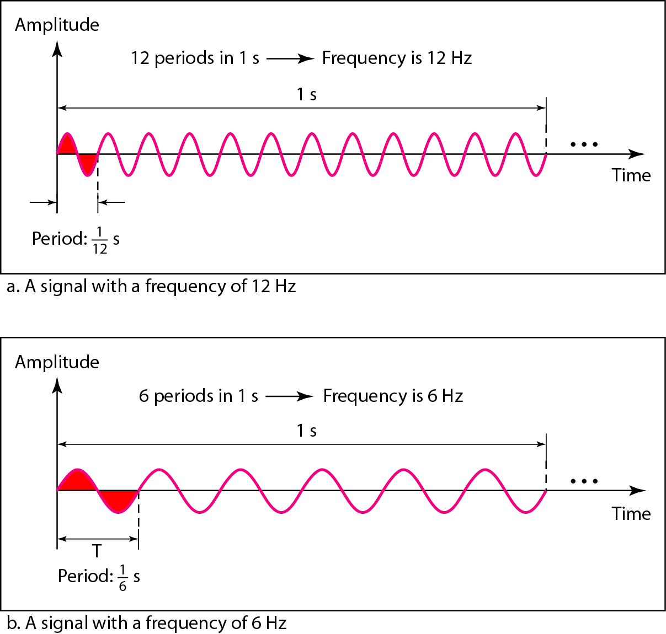
Figure 3.5 Two signals with the same amplitude and phase, but different frequencies

Slide 17
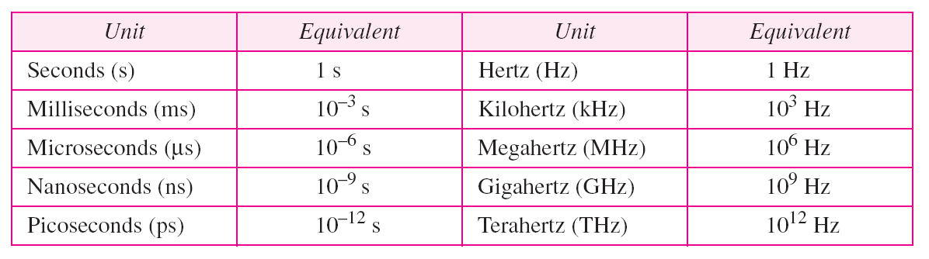
Table 3.1 Units of period and frequency

Slide 18
Example 3.3
The power we use at home has a frequency of 60 Hz. The period of this sine wave can be determined as follows:

Slide 19
Example 3.4
Express a period of 100 ms in microseconds.
Solution
From Table 3.1 we find the equivalents of 1 ms (1 ms is 10⁻³ s) and 1 s (1 s is 10⁶ μs). We make the following substitutions:.

Slide 20
Example 3.5
The period of a signal is 100 ms. What is its frequency in kilohertz?
Solution
First we change 100 ms to seconds, and then we calculate the frequency from the period (1 Hz = 10⁻³ kHz).

Slide 21
Note
Frequency is the rate of change with respect to time. Change in a short span of time
means high frequency. Change over a long span of time means low frequency.

Slide 22
Note
If a signal does not change at all, its frequency is zero.
If a signal changes instantaneously, its frequency is infinite.

Slide 23
Note
Phase describes the position of the waveform relative to time 0.

Slide 24
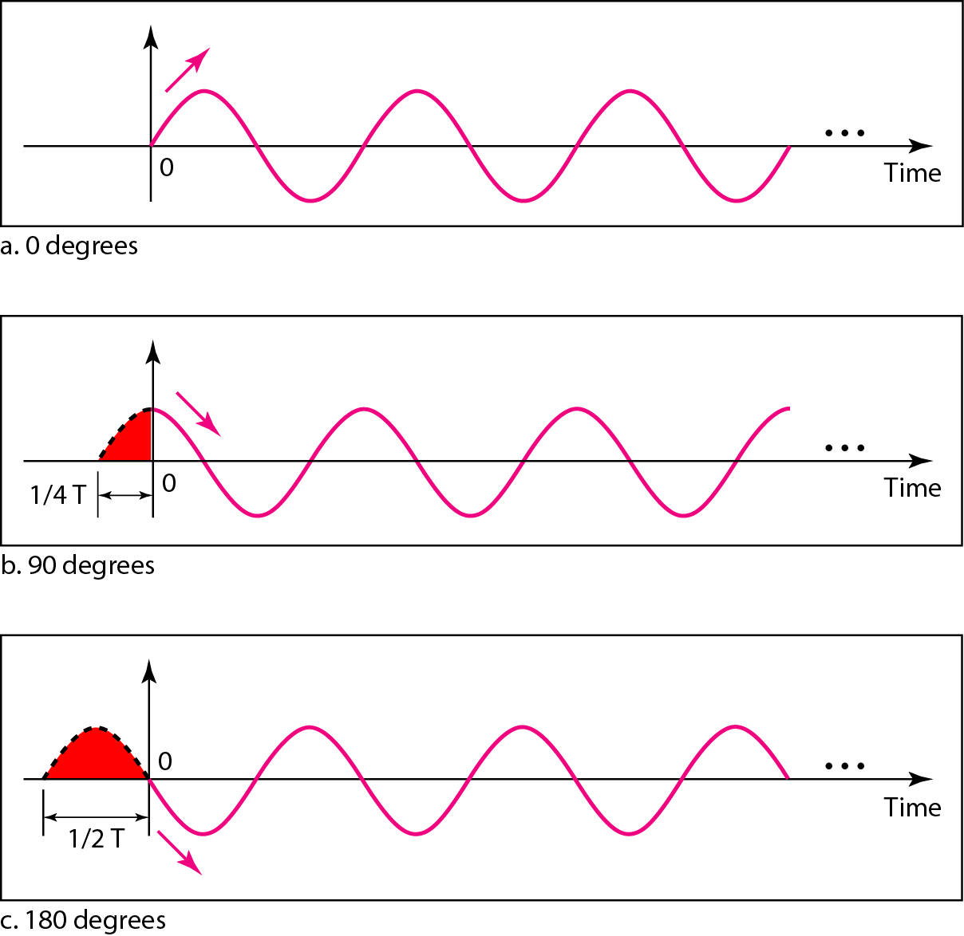
Figure 3.5 Three sine waves with the same amplitude and frequency, but different phases

Slide 25
Example 3.6
A sine wave is offset 1/6 cycle with respect to time 0. What is its phase in degrees and radians?
Solution
We know that 1 complete cycle is 360°. Therefore, 1/6 cycle is

Slide 26
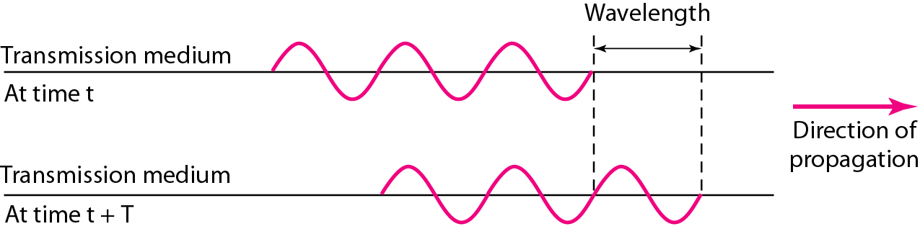
Figure 3.7 Wavelength and period

Slide 27
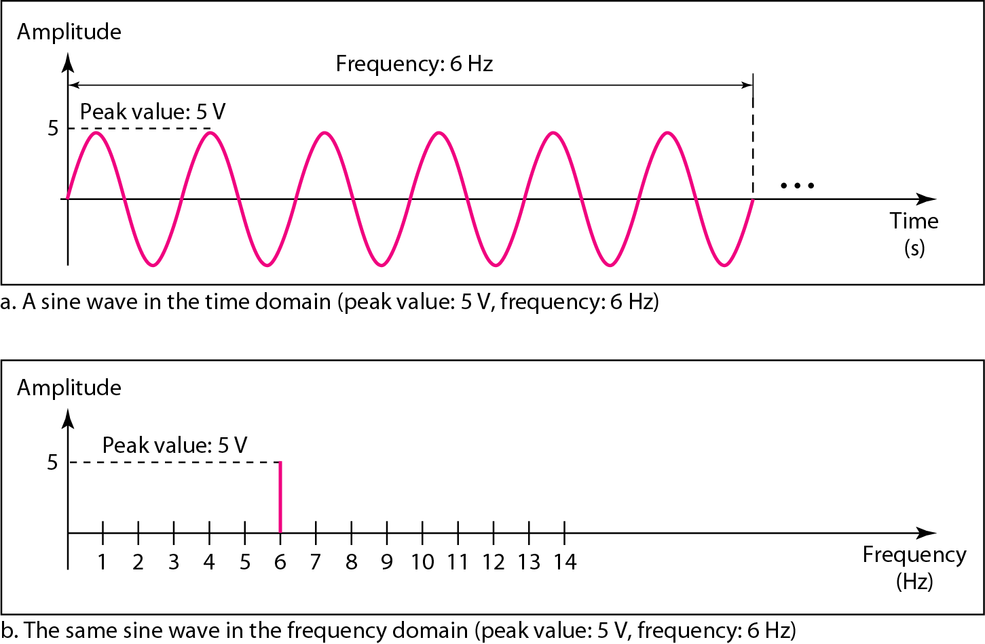
Figure 3.8 The time-domain and frequency-domain plots of a sine wave

Slide 28
Note
A complete sine wave in the time domain can be represented by one single spike in the frequency domain.

Slide 29
Example 3.7
The frequency domain is more compact and useful when we are dealing with more than one sine wave.
For example, Figure 3.9 shows three sine waves, each with different amplitude and frequency.
All can be represented by three spikes in the frequency domain.

Slide 30
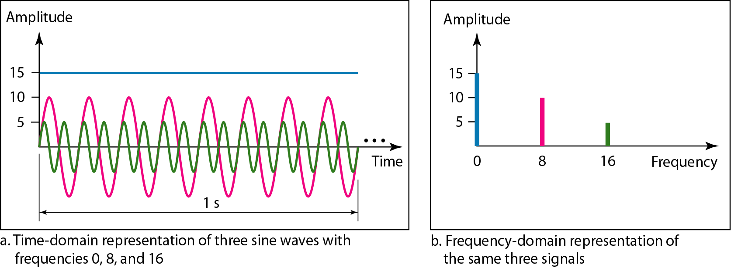
Figure 3.9 The time domain and frequency domain of three sine waves

Slide 31
Note
A single-frequency sine wave is not useful in data communications;
we need to send a composite signal, a signal made of many simple sine waves.

Slide 32
Note
According to Fourier analysis, any composite signal is a combination of
simple sine waves with different frequencies, amplitudes, and phases.
Fourier analysis is discussed in Appendix E.

Slide 33
Note
Periodic composite signal is periodic - series of signals with discrete frequencies;
Nonperiodic composite signal - a combination of sine waves with continuous frequencies.

Slide 34
Example 3.8
Figure 3.9 shows a periodic composite signal with frequency f. This type of signal is not typical of those found in data communications. We can consider it to be three alarm systems, each with a different frequency. The analysis of this signal can give us a good understanding of how to decompose signals.

Slide 35
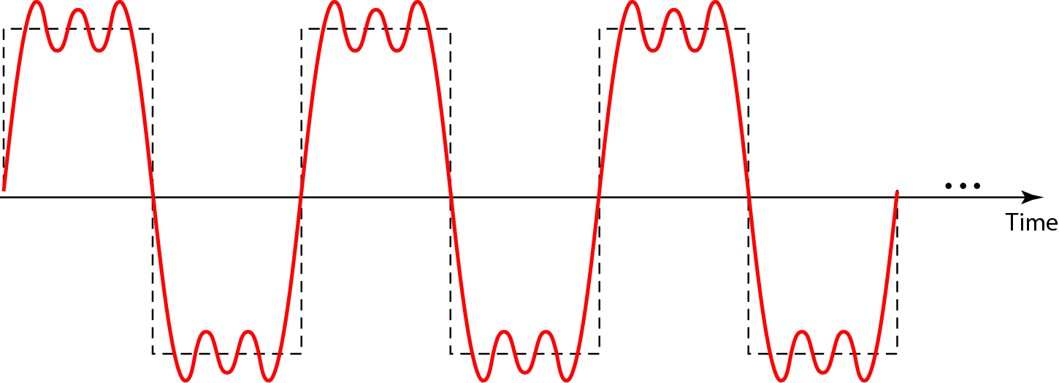
Figure 3.10 A composite periodic signal

Slide 36
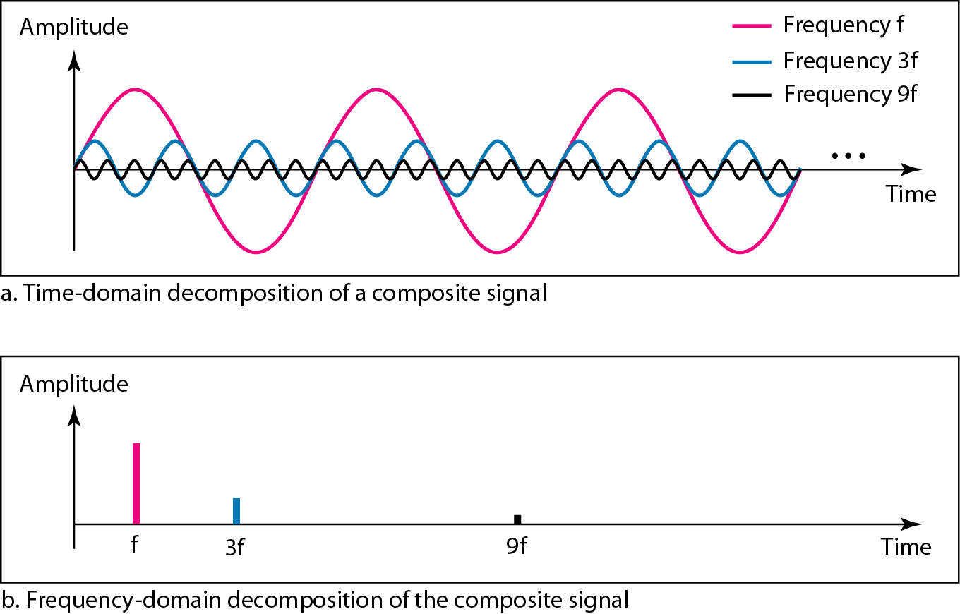
Figure 3.11 Decomposition of a composite periodic signal in the time and frequency domains

Slide 37
Example 3.9
Figure 3.11 shows a nonperiodic composite signal. It can be the signal created by a microphone or a telephone set when a word or two is pronounced. In this case, the composite signal cannot be periodic, because that implies that we are repeating the same word or words with exactly the same tone.

Slide 38
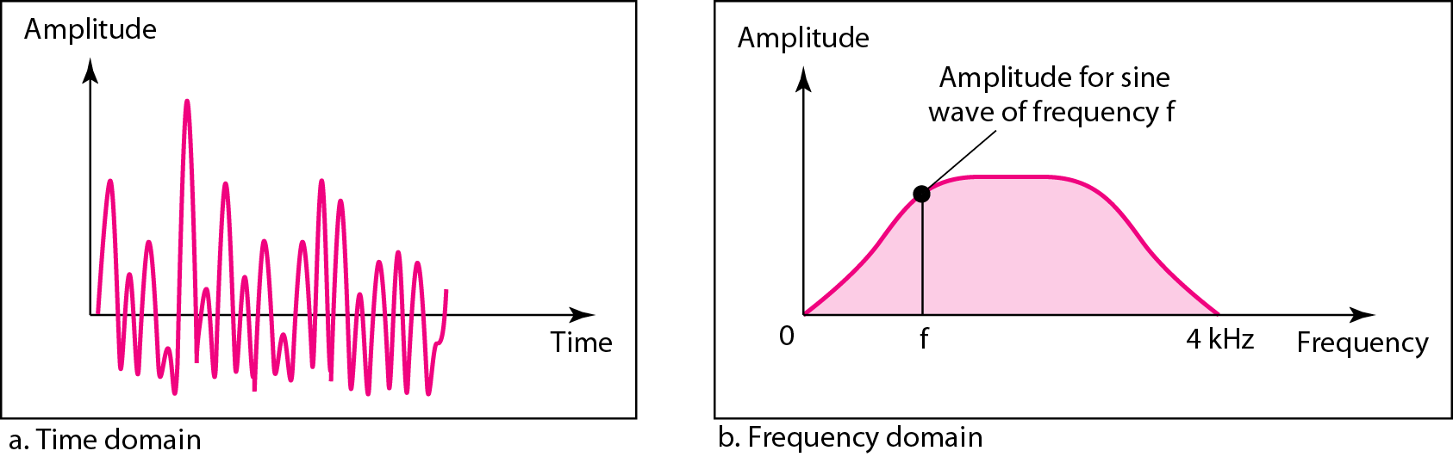
Figure 3.12 The time and frequency domains of a nonperiodic signal

Slide 39
Bandwidth
The range of frequencies contained in a composite signal is its bandwidth.
The bandwidth of a composite signal is the difference between the highest and the lowest frequencies contained in that signal.

Slide 40
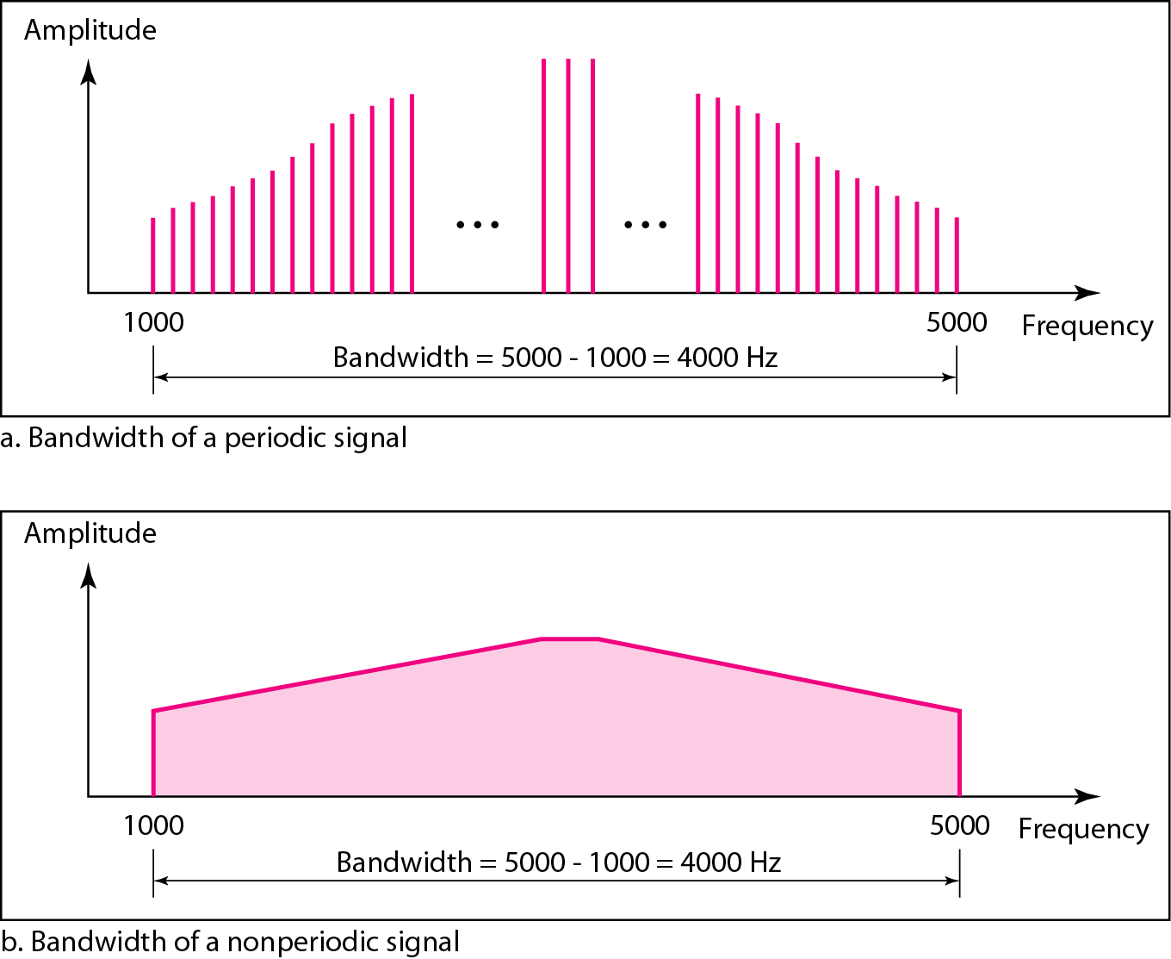
Figure 3.13 The bandwidth of periodic and nonperiodic composite signals

Slide 41
Example 3.10
If a periodic signal is decomposed into five sine waves with frequencies of 100, 300, 500, 700, and 900 Hz, what is its bandwidth? Draw the spectrum, assuming all components have a maximum amplitude of 10 V.
Solution
Let f_{h} be the highest frequency, f_{l} the lowest frequency, and B the bandwidth. Then
The spectrum has only five spikes, at 100, 300, 500, 700, and 900 Hz (see Figure 3.13).

Slide 42
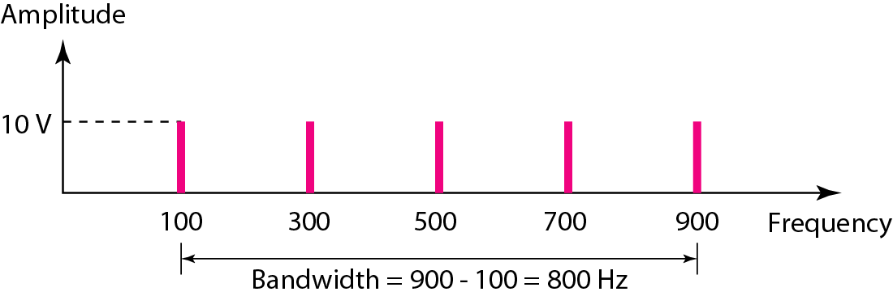
Figure 3.14 The bandwidth for Example 3.10

Slide 43
Example 3.11
A periodic signal has a bandwidth of 20 Hz. The highest frequency is 60 Hz. What is the lowest frequency? Draw the spectrum if the signal contains all frequencies of the same amplitude.
Solution
Let f_{h} be the highest frequency, f_{l} the lowest frequency, and B the bandwidth. Then
The spectrum contains all integer frequencies. We show this by a series of spikes (see Figure 3.15).

Slide 44
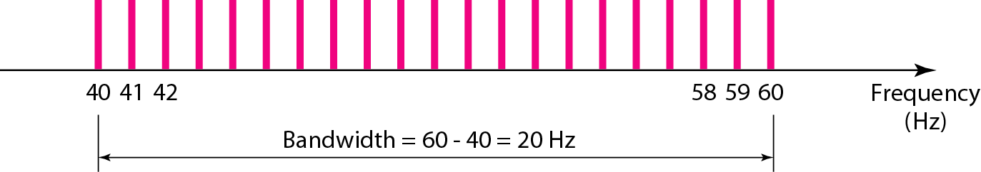
Figure 3.15 The bandwidth for Example 3.11

Slide 45
Example 3.12
A nonperiodic composite signal has a bandwidth of 200 kHz, with a middle frequency of 140 kHz and peak amplitude of 20 V. The two extreme frequencies have an amplitude of 0. Draw the frequency domain of the signal.
Solution
The lowest frequency must be at 40 kHz and the highest at 240 kHz. Figure 3.15 shows the frequency domain and the bandwidth.

Slide 46
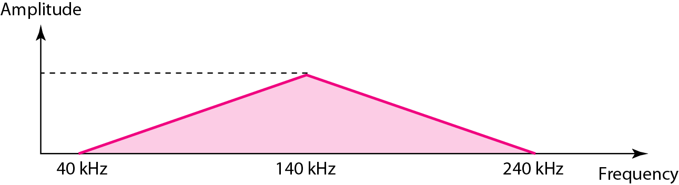
Figure 3.16 The bandwidth for Example 3.12

Slide 47
Example 3.13
An example of a nonperiodic composite signal is the signal propagated by an AM radio station. In the United States, each AM radio station is assigned a 10-kHz bandwidth. The total bandwidth dedicated to AM radio ranges from 530 to 1700 kHz. We will show the rationale behind this 10-kHz bandwidth in Chapter 5.

Slide 48
Example 3.14
Another example of a nonperiodic composite signal is the signal propagated by an FM radio station. In the United States, each FM radio station is assigned a 200-kHz bandwidth. The total bandwidth dedicated to FM radio ranges from 88 to 108 MHz. We will show the rationale behind this 200-kHz bandwidth in Chapter 5.

Slide 49
Example 3.15
Another example of a nonperiodic composite signal is the signal received by an old-fashioned analog black-and-white TV. A TV screen is made up of pixels. If we assume a resolution of 525 × 700, we have 367,500 pixels per screen. If we scan the screen 30 times per second, this is 367,500 × 30 = 11,025,000 pixels per second. The worst-case scenario is alternating black and white pixels. We can send 2 pixels per cycle. Therefore, we need 11,025,000 / 2 = 5,512,500 cycles per second, or Hz. The bandwidth needed is 5.5125 MHz.

Slide 50
3.3 DIGITAL SIGNALS
In addition to being represented by an analog signal, information can also be represented by a digital signal. For example, a 1 can be encoded as a positive voltage and a 0 as zero voltage. A digital signal can have more than two levels. In this case, we can send more than 1 bit for each level.
Topics discussed in this section:
Bit Rate Bit Length Digital Signal as a Composite Analog Signal
Application Layer

Slide 51
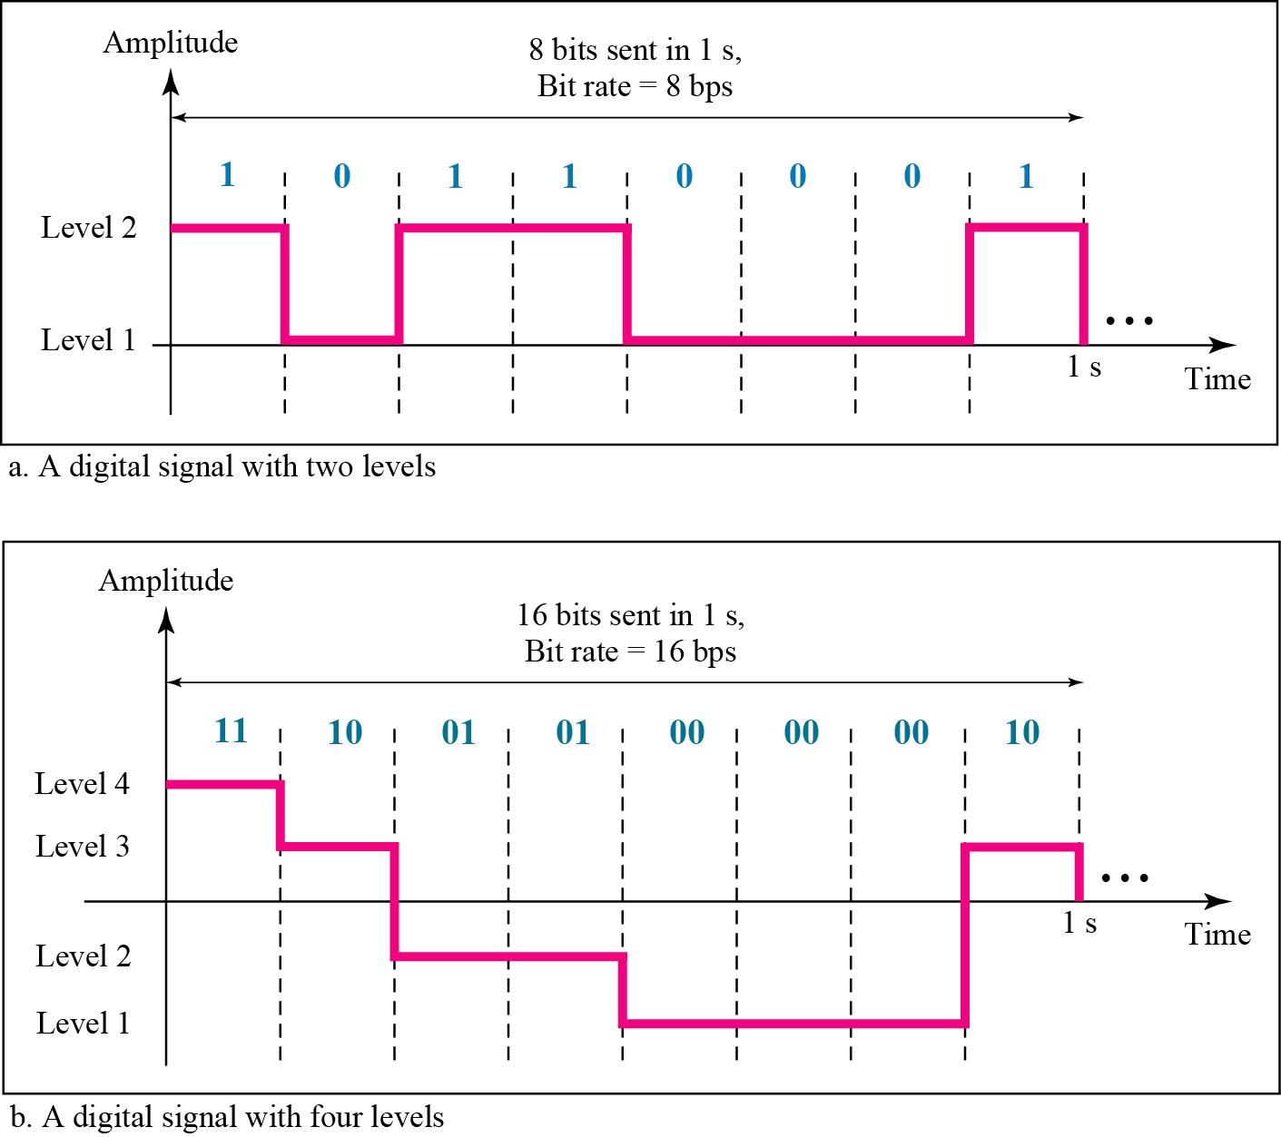
Figure 3.17 Two digital signals: one with two signal levels and the other with four signal levels

Slide 52
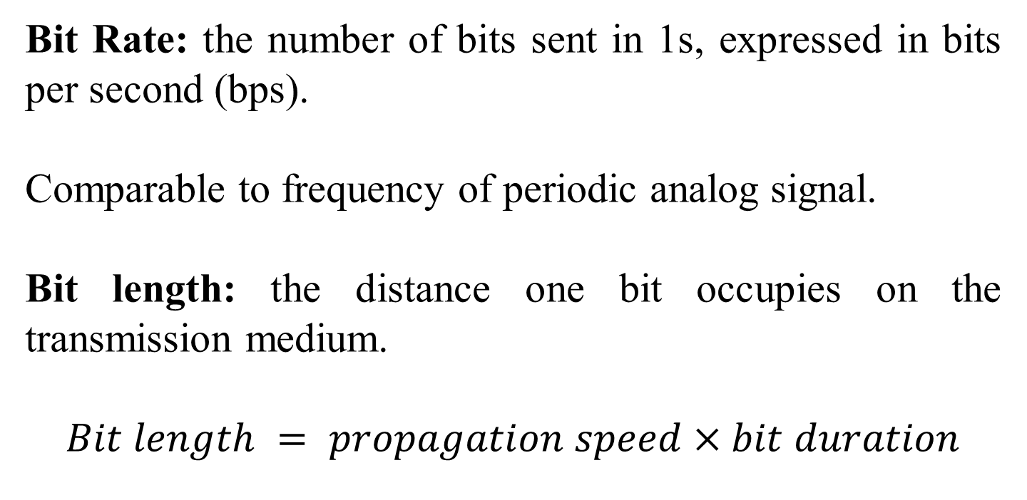
Bit Rate: the number of bits sent in 1s, expressed in bits per second (bps).
Comparable to frequency of periodic analog signal.
Bit length: the distance one bit occupies on the transmission medium.
$$Bit length = propagation speed×bit duration$$

Slide 53
Example 3.16
A digital signal has eight levels. How many bits are needed per level? We calculate the number of bits from the formula
Each signal level is represented by 3 bits.

Slide 54
Example 3.17
A digital signal has nine levels. How many bits are needed per level? We calculate the number of bits by using the formula. Each signal level is represented by 3.17 bits. However, this answer is not realistic. The number of bits sent per level needs to be an integer as well as a power of 2. For this example, 4 bits can represent one level.

Slide 55
Example 3.18
Assume we need to download text documents at the rate of 100 pages per minute. What is the required bit rate of the channel?
Solution
A page is an average of 24 lines with 80 characters in each line. If we assume that one character requires 8 bits, the bit rate is

Slide 56
Example 3.19
A digitized voice channel, as we will see in Chapter 4, is made by digitizing a 4-kHz bandwidth analog voice signal. We need to sample the signal at twice the highest frequency (two samples per hertz). We assume that each sample requires 8 bits. What is the required bit rate?
Solution
The bit rate can be calculated as

Slide 57
Example 3.20
What is the bit rate for high-definition TV (HDTV)?
Solution
HDTV uses digital signals to broadcast high quality video signals. The HDTV screen is normally a ratio of 16 : 9. There are 1920 by 1080 pixels per screen, and the screen is renewed 30 times per second. Twenty-four bits represents one color pixel.
The TV stations reduce this rate to 20 to 40 Mbps through compression.

Slide 58
Digital Signal as a Composite Analog Signal

Slide 59
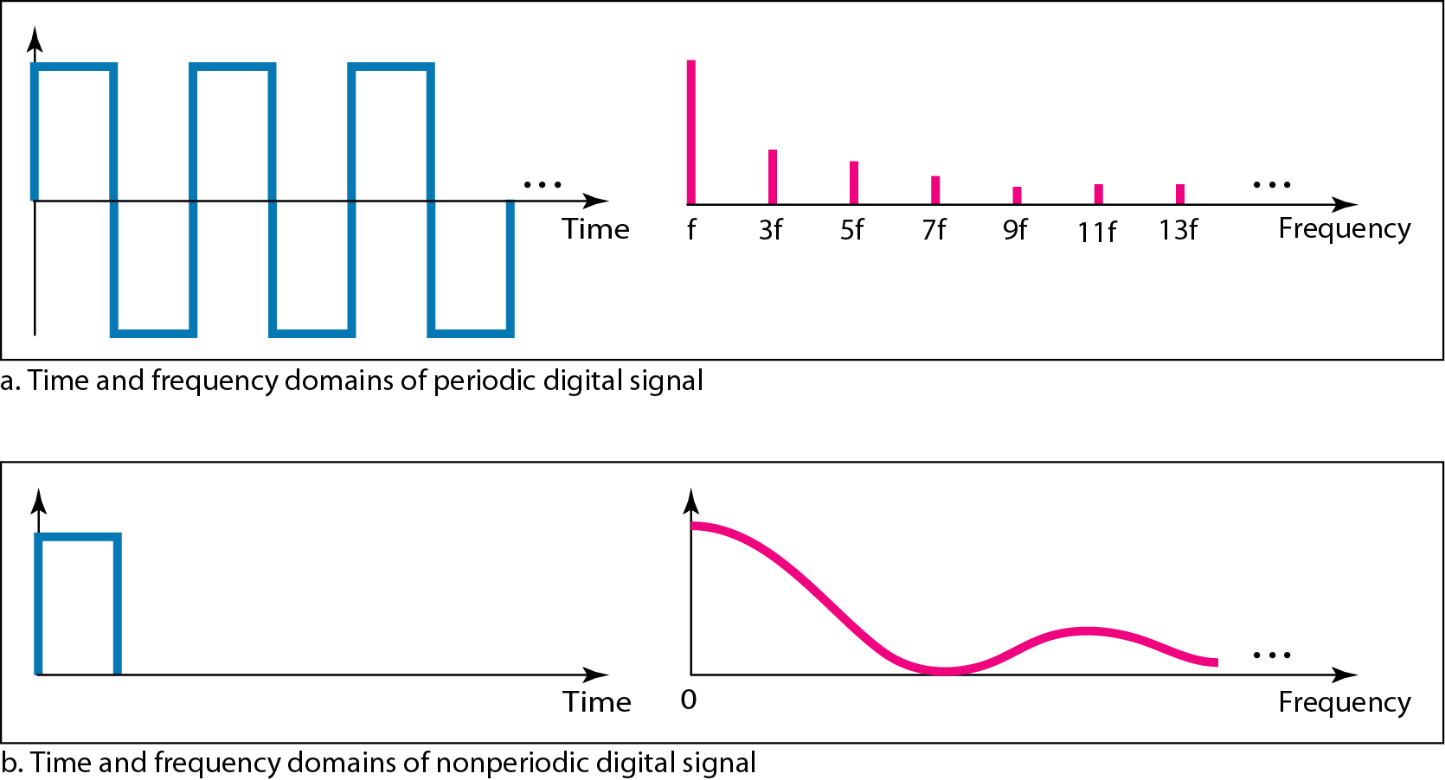
Figure 3.18 The time and frequency domains of periodic and nonperiodic digital signals

Slide 60
Transmission of Digital Signals
Baseband Transmission
(low-pass channel)
Sending a digital signal over a channel without changing
the digital signal to an analog signal

Slide 61
Note
A digital signal is a composite analog signal with an infinite bandwidth.
It starts from zero frequency.

Slide 62
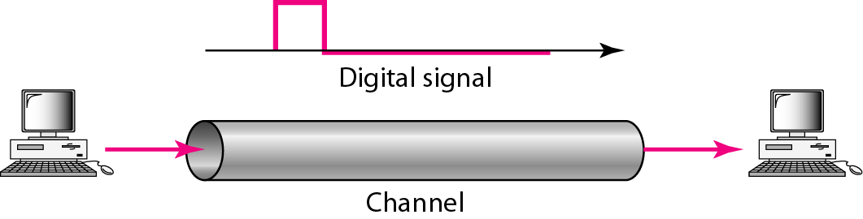
Figure 3.19 Baseband transmission
Sending a digital signal over a channel without changing
the digital signal to an analog signal.
Baseband transmission requires a low-pass channel.
Low-pass channel allows a bandwidth starting from zero.
Ideally low-pass channel with infinite bandwidth is required.

Slide 63
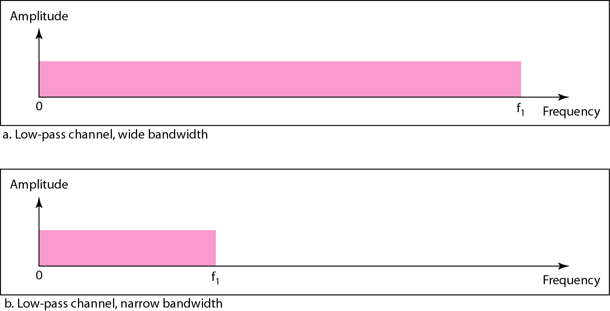
Figure 3.20 Bandwidths of two low-pass channels

Slide 64
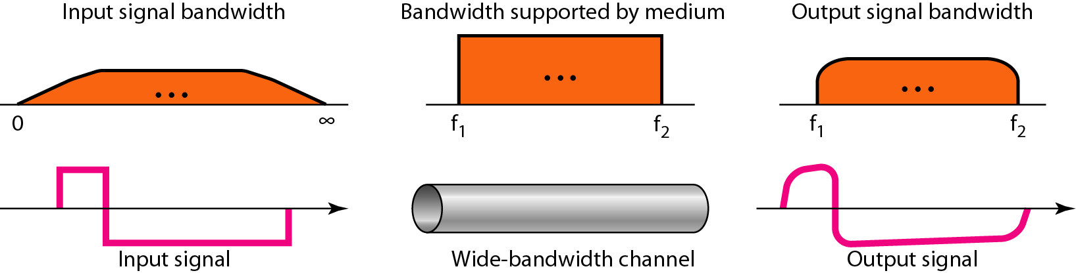
Figure 3.21 Baseband transmission using a dedicated medium
If f₁ is very close to zero and f₂ is very high, the vertical and horizontal components of the digital signal is affected in very small scale.

Slide 65
Note
Baseband transmission of a digital signal that preserves the shape of the digital signal is possible only if we have a low-pass channel with an infinite or very wide bandwidth.

Slide 66
Example 3.21
An example of a dedicated channel where the entire bandwidth of the medium is used as one single channel is a LAN. Almost every wired LAN today uses a dedicated channel for two stations communicating with each other. In a bus topology LAN with multipoint connections, only two stations can communicate with each other at each moment in time (timesharing); the other stations need to refrain from sending data. In a star topology LAN, the entire channel between each station and the hub is used for communication between these two entities. We study LANs in Chapter 14.

Slide 67
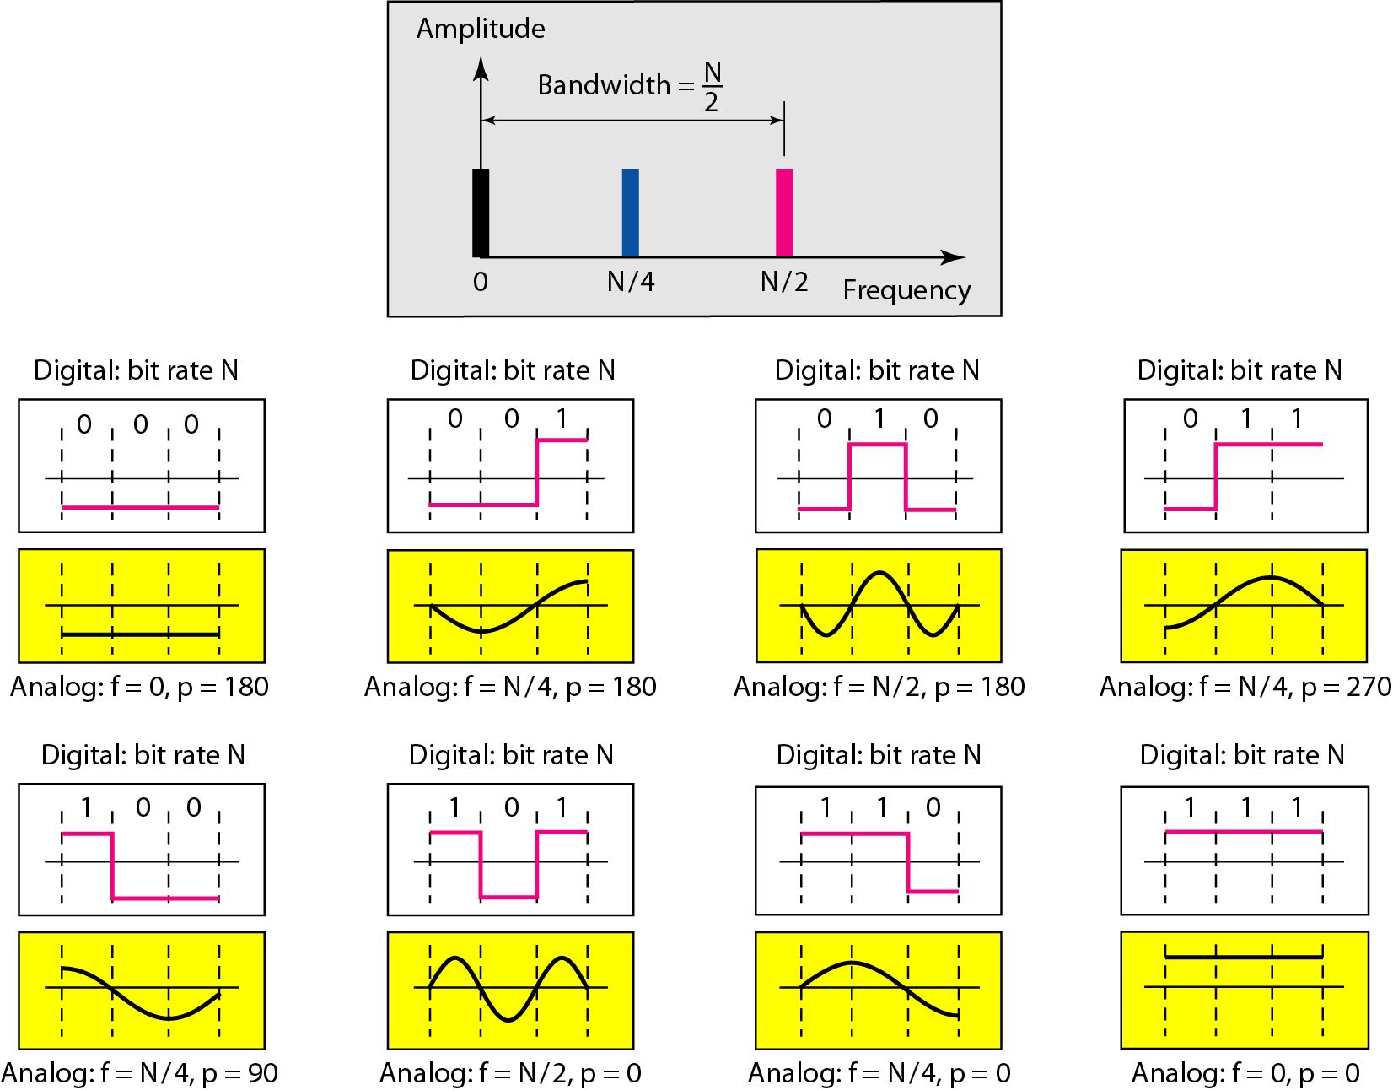
Figure 3.21 Rough approximation of a digital signal using the first harmonic for worst case

Slide 68
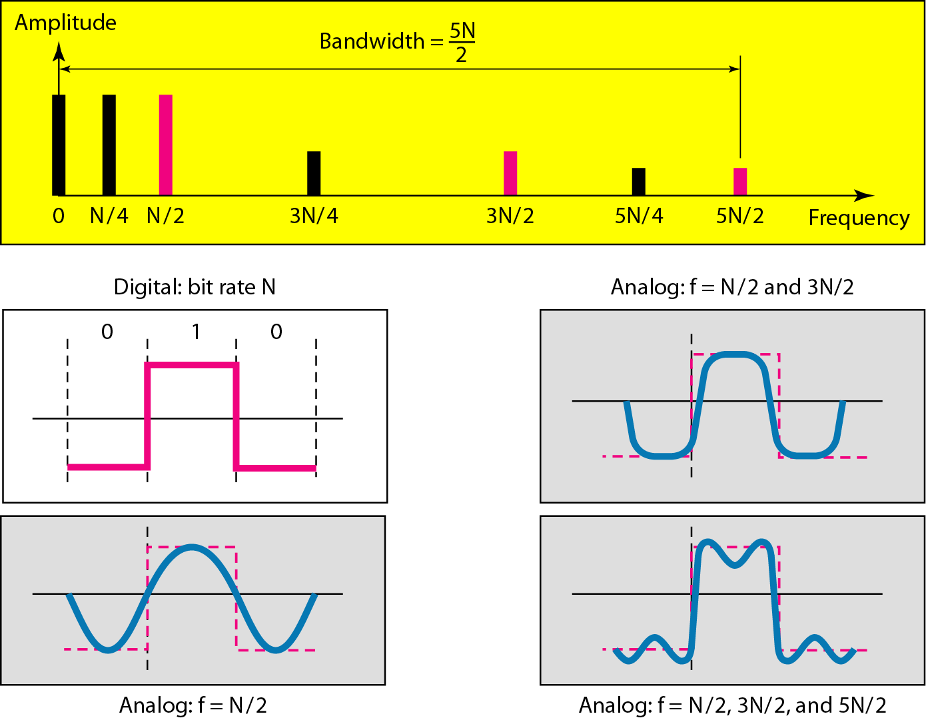
Figure 3.22 Simulating a digital signal with first three harmonics
https://www.desmos.com/calculator/5yp953jhxu

Slide 69
Note
In baseband transmission, the required bandwidth is proportional to the bit rate;
if we need to send bits faster, we need more bandwidth.
In baseband transmission, the required bandwidth is proportional to the bit rate;
if we need to send bits faster, we need more bandwidth.

Slide 70
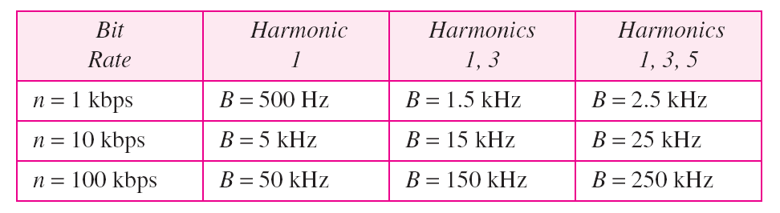
Table 3.2 Bandwidth requirements

Slide 71
Example 3.22
What is the required bandwidth of a low-pass channel if we need to send 1 Mbps by using baseband transmission?
Solution
The answer depends on the accuracy desired.
a. The minimum bandwidth, is B = bit rate /2, or 500 kHz.
b. A better solution is to use the first and the third harmonics with B = 3 × 500 kHz = 1.5 MHz.
c. Still a better solution is to use the first, third, and fifth harmonics with B = 5 × 500 kHz = 2.5 MHz.

Slide 72
Example 3.22
We have a low-pass channel with bandwidth 100 kHz. What is the maximum bit rate of this channel?
Solution
The maximum bit rate can be achieved if we use the first harmonic. The bit rate is 2 times the available bandwidth, or 200 kbps.

Slide 73
Broadband Transmission
(Using Modulation)
changing the digital signal to an analog signal for transmission.

Slide 74
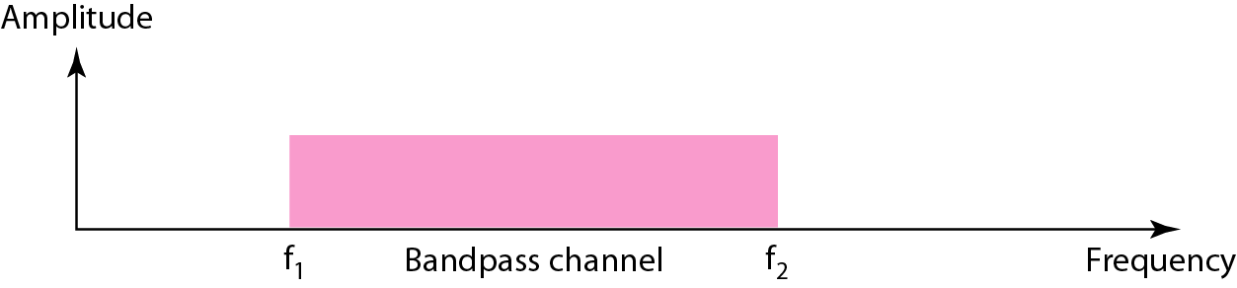
Figure 3.24 Bandwidth of a bandpass channel

Slide 75
Note
If the available channel is a bandpass channel, we cannot send the digital signal directly to the channel; we need to convert the digital signal to an analog signal before transmission.

Slide 76
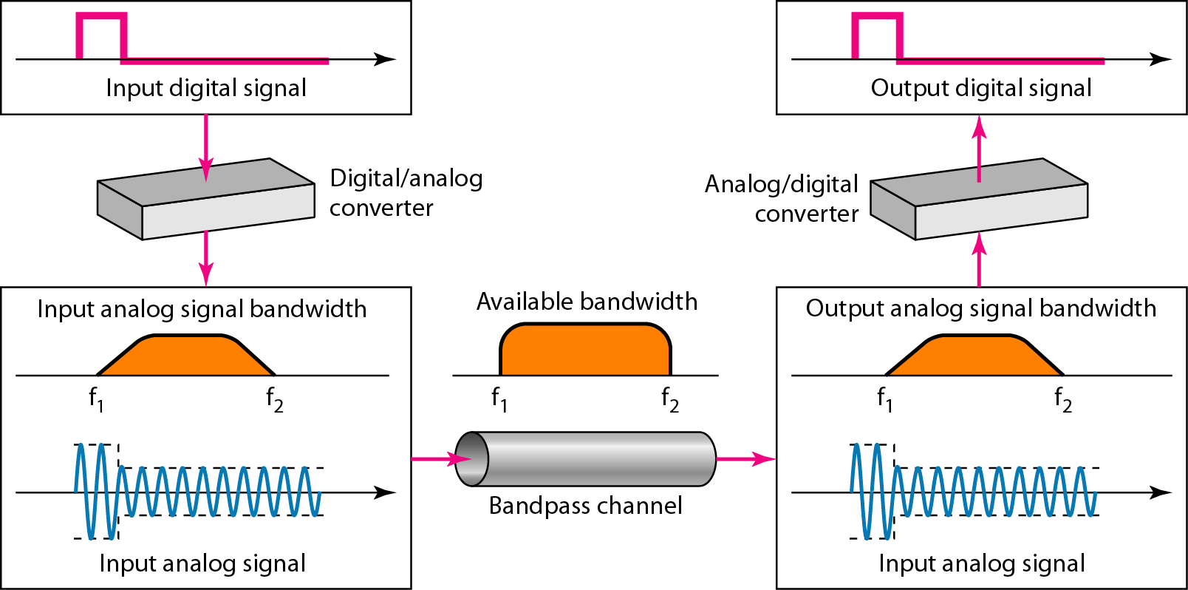
Figure 3.25 Modulation of a digital signal for transmission on a bandpass channel

Slide 77
Example 3.24
An example of broadband transmission using modulation is the sending of computer data through a telephone subscriber line, the line connecting a resident to the central telephone office. These lines are designed to carry voice with a limited bandwidth. The channel is considered a bandpass channel. We convert the digital signal from the computer to an analog signal, and send the analog signal. We can install two converters to change the digital signal to analog and vice versa at the receiving end. The converter, in this case, is called a modem which we discuss in detail in Chapter 5.

Slide 78
Example 3.25
A second example is the digital cellular telephone. For better reception, digital cellular phones convert the analog voice signal to a digital signal (see Chapter 16). Although the bandwidth allocated to a company providing digital cellular phone service is very wide, we still cannot send the digital signal without conversion. The reason is that we only have a bandpass channel available between caller and callee. We need to convert the digitized voice to a composite analog signal before sending.

Slide 79
3-4 TRANSMISSION IMPAIRMENT
Signals travel through transmission media, which are not perfect. The imperfection causes signal impairment. This means that the signal at the beginning of the medium is not the same as the signal at the end of the medium. What is sent is not what is received. Three causes of impairment are attenuation, distortion, and noise.
Topics discussed in this section:
Attenuation Distortion Noise

Slide 80
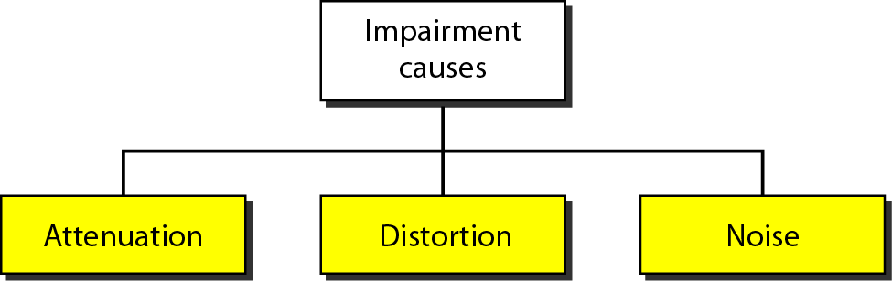
Figure 3.26 Causes of impairment

Slide 81
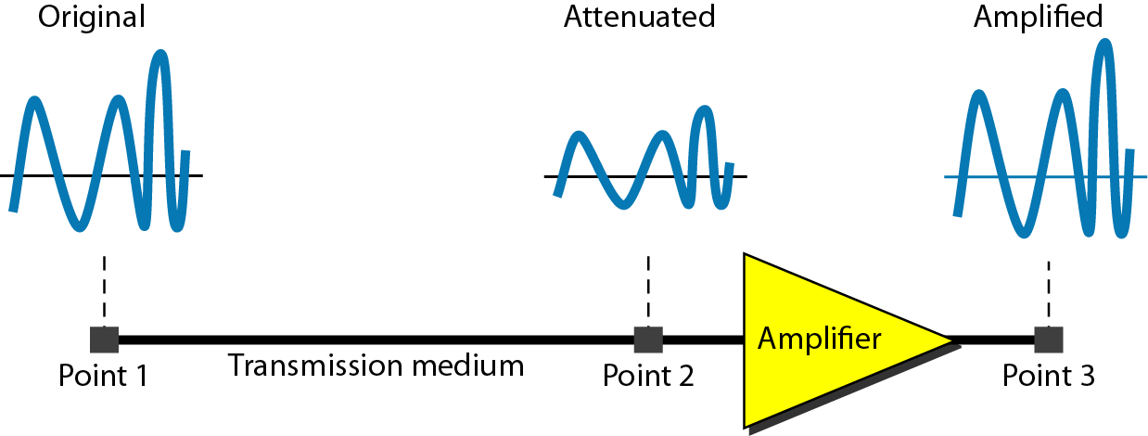
Figure 3.27 Attenuation

Slide 82

Example 3.26
Suppose a signal travels through a transmission medium and its power is reduced to one-half. This means that P₂ is (1/2)P₁. In this case, the attenuation (loss of power) can be calculated as
A loss of 3 dB (–3 dB) is equivalent to losing one-half the power.

Slide 83

Example 3.27
A signal travels through an amplifier, and its power is increased 10 times. This means that P₂ = 10P₁ . In this case, the amplification (gain of power) can be calculated as

Slide 84

Example 3.28
One reason that engineers use the decibel to measure the changes in the strength of a signal is that decibel numbers can be added (or subtracted) when we are measuring several points (cascading) instead of just two. In Figure 3.27 a signal travels from point 1 to point 4. In this case, the decibel value can be calculated as

Slide 85
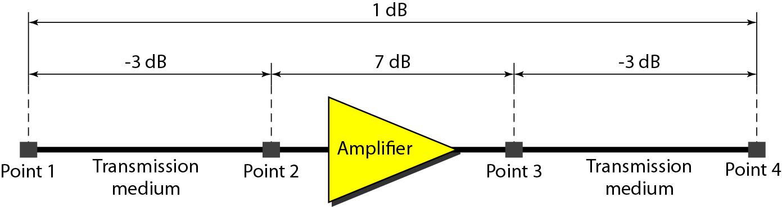
Figure 3.28 Decibels for Example 3.28

Slide 86
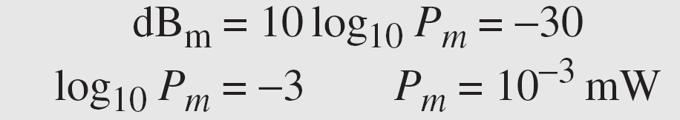
Example 3.29
Sometimes the decibel is used to measure signal power in milliwatts. In this case, it is referred to as dB_{m} and is calculated as dB_{m} = 10 log10 P_{m} , where P_{m} is the power in milliwatts. Calculate the power of a signal with dB_{m} = −30.
Solution
We can calculate the power in the signal as

Slide 87
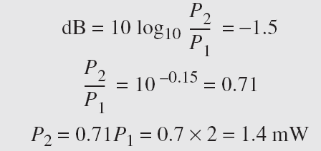
Example 3.30
The loss in a cable is usually defined in decibels per kilometer (dB/km). If the signal at the beginning of a cable with −0.3 dB/km has a power of 2 mW, what is the power of the signal at 5 km?
Solution
The loss in the cable in decibels is 5 × (−0.3) = −1.5 dB. We can calculate the power as

Slide 88
Distortion
Distortion means that the signal changes its form or shape

Slide 89
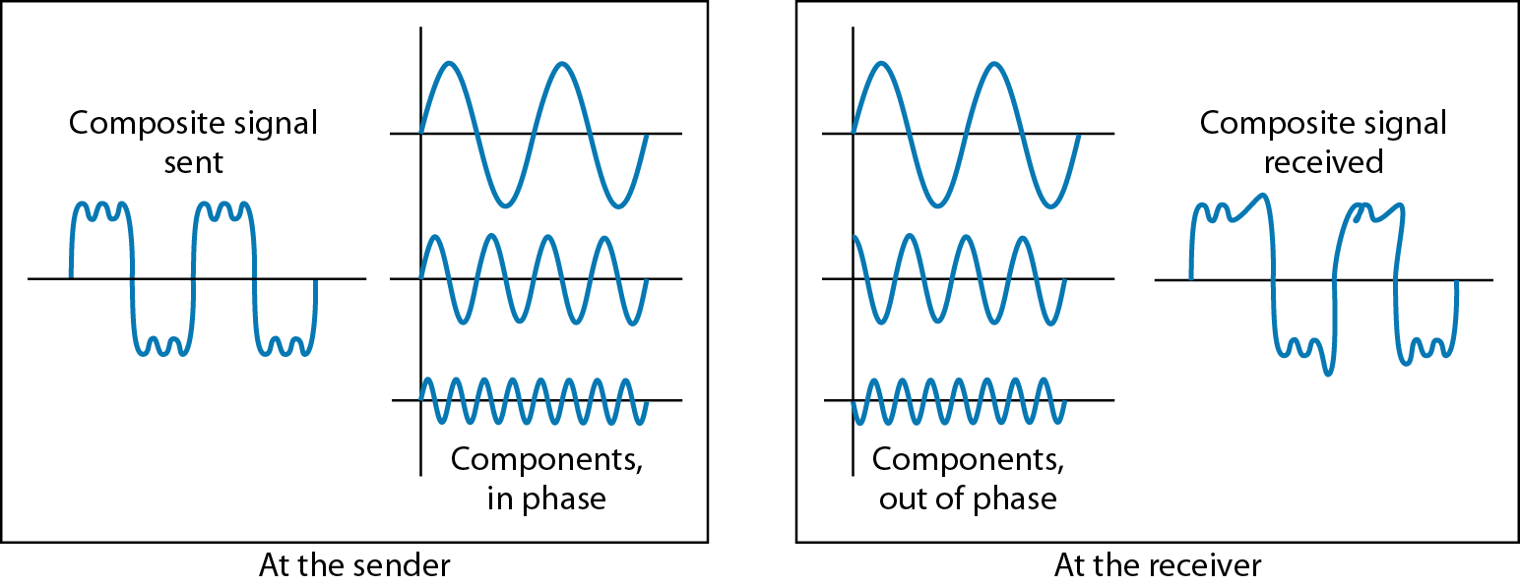
Figure 3.29 Distortion

Slide 90
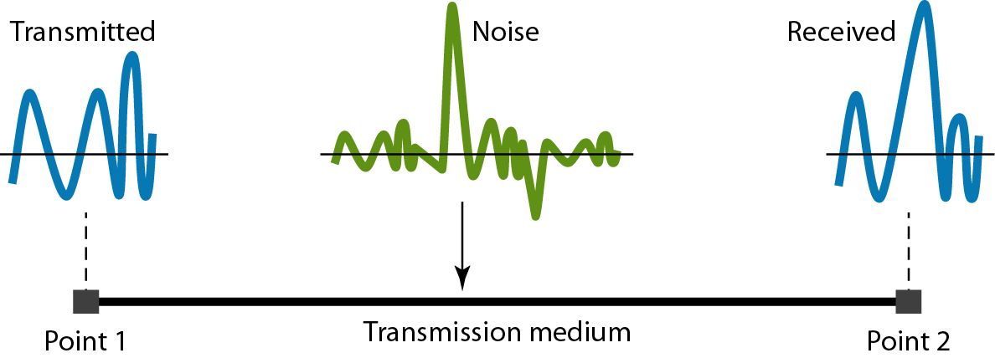
Figure 3.30 Noise

Slide 91
Example 3.31
The power of a signal is 10 mW and the power of the noise is 1 μW; what are the values of SNR and SNR_{dB} ?
Solution
The values of SNR and SNR_{dB} can be calculated as follows:

Slide 92
Example 3.32
The values of SNR and SNR_{dB} for a noiseless channel are
We can never achieve this ratio in real life; it is an ideal.

Slide 93
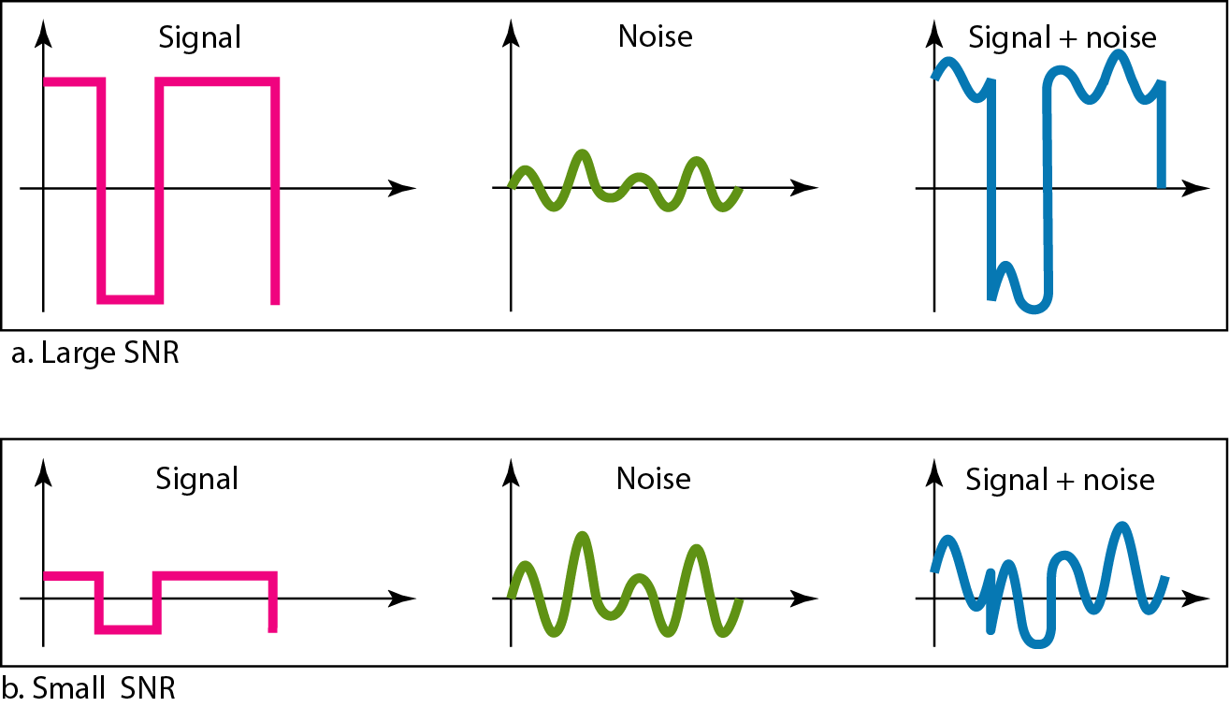
Figure 3.31 Two cases of SNR: a high SNR and a low SNR

Slide 94
3-5 DATA RATE LIMITS
A very important consideration in data communications is how fast we can send data, in bits per second, over a channel. Data rate depends on three factors:
1. The bandwidth available
2. The level of the signals we use
3. The quality of the channel (the level of noise)
Topics discussed in this section:
Noiseless Channel: Nyquist Bit Rate Noisy Channel: Shannon Capacity Using Both Limits

Slide 95
Noiseless Channel: Nyquist Bit Rate
BitRate = 2 x bandwidth x log₂L
formula

Slide 96
Note
Increasing the levels of a signal may reduce the reliability of the system.

Slide 97
Example 3.34
Consider a noiseless channel with a bandwidth of 3000 Hz transmitting a signal with two signal levels. The maximum bit rate can be calculated as

Slide 98
Example 3.35
Consider the same noiseless channel transmitting a signal with four signal levels (for each level, we send 2 bits). The maximum bit rate can be calculated as

Slide 99
Example 3.36
We need to send 265 kbps over a noiseless channel with a bandwidth of 20 kHz. How many signal levels do we need?
Solution
We can use the Nyquist formula as shown:
Since this result is not a power of 2, we need to either increase the number of levels or reduce the bit rate. If we have 128 levels, the bit rate is 280 kbps. If we have 64 levels, the bit rate is 240 kbps.

Slide 100
Noisy Channel: Shannon Capacity
Capacity = bandwidth x log₂(1 + SNR)
formula

Slide 101
Example 3.37
Consider an extremely noisy channel in which the value of the signal-to-noise ratio is almost zero. In other words, the noise is so strong that the signal is faint. For this channel the capacity C is calculated as
This means that the capacity of this channel is zero regardless of the bandwidth. In other words, we cannot receive any data through this channel.

Slide 102
Example 3.38
We can calculate the theoretical highest bit rate of a regular telephone line. A telephone line normally has a bandwidth of 3000. The signal-to-noise ratio is usually 3162. For this channel the capacity is calculated as
This means that the highest bit rate for a telephone line is 34.860 kbps. If we want to send data faster than this, we can either increase the bandwidth of the line or improve the signal-to-noise ratio.

Slide 103
Example 3.39
The signal-to-noise ratio is often given in decibels. Assume that SNR_{dB} = 36 and the channel bandwidth is 2 MHz. The theoretical channel capacity can be calculated as

Slide 104


Example 3.40
For practical purposes, when the SNR is very high, we can assume that SNR + 1 is almost the same as SNR. In these cases, the theoretical channel capacity can be simplified to
For example, we can calculate the theoretical capacity of the previous example as

Slide 105
Example 3.41
We have a channel with a 1-MHz bandwidth. The SNR for this channel is 63. What are the appropriate bit rate and signal level?
Solution
First, we use the Shannon formula to find the upper limit.

Slide 106
Example 3.41 (continued)
The Shannon formula gives us 6 Mbps, the upper limit. For better performance we choose something lower, 4 Mbps, for example. Then we use the Nyquist formula to find the number of signal levels.

Slide 107
Note
The Shannon capacity gives us the upper limit; the Nyquist formula tells us how many signal levels we need.

Slide 108
3-6 PERFORMANCE
One important issue in networking is the performance of the network—how good is it? We discuss quality of service, an overall measurement of network performance, in greater detail in Chapter 24. In this section, we introduce terms that we need for future chapters.
Topics discussed in this section:
Bandwidth Throughput Latency (Delay)
Bandwidth-Delay Product

Slide 109
Performance: Bandwidth
Note
In networking, we use the term bandwidth in two contexts.
❏The first, bandwidth in hertz, refers to the range of frequencies in a composite signal or the range of frequencies that a channel can pass.
❏The second, bandwidth in bits per second, refers to the speed of bit transmission in a channel or link.

Slide 110
Example 3.42
The bandwidth of a subscriber line is 4 kHz for voice or data. The bandwidth of this line for data transmission
can be up to 56,000 bps using a sophisticated modem to change the digital signal to analog.

Slide 111
Example 3.43
If the telephone company improves the quality of the line and increases the bandwidth to 8 kHz, we can send 112,000 bps by using the same technology as mentioned in Example 3.42.

Slide 112

Example 3.44
A network with bandwidth of 10 Mbps can pass only an average of 12,000 frames per minute with each frame carrying an average of 10,000 bits. What is the throughput of this network?
Solution
We can calculate the throughput as
The throughput is almost one-fifth of the bandwidth in this case.

Slide 113
Example 3.45
What is the propagation time if the distance between the two points is 12,000 km? Assume the propagation speed to be 2.4 × 108 m/s in cable.
Solution
We can calculate the propagation time as
The example shows that a bit can go over the Atlantic Ocean in only 50 ms if there is a direct cable between the source and the destination.

Slide 114
Example 3.46
What are the propagation time and the transmission time for a 2.5-kbyte message (an e-mail) if the bandwidth of the network is 1 Gbps? Assume that the distance between the sender and the receiver is 12,000 km and that light travels at 2.4 × 108 m/s.
Solution
We can calculate the propagation and transmission time as shown on the next slide:

Slide 115
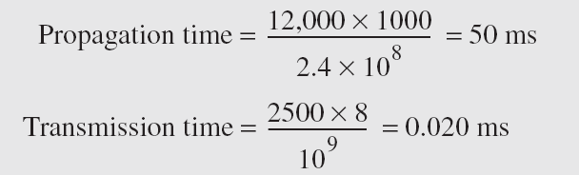
Example 3.46 (continued)
Note that in this case, because the message is short and the bandwidth is high, the dominant factor is the propagation time, not the transmission time. The transmission time can be ignored.

Slide 116
Example 3.47
What are the propagation time and the transmission time for a 5-Mbyte message (an image) if the bandwidth of the network is 1 Mbps? Assume that the distance between the sender and the receiver is 12,000 km and that light travels at 2.4 × 10⁸ m/s.
Solution
We can calculate the propagation and transmission times as shown on the next slide.

Slide 117
Example 3.47 (continued)
Note that in this case, because the message is very long and the bandwidth is not very high, the dominant factor is the transmission time, not the propagation time. The propagation time can be ignored.

Slide 118
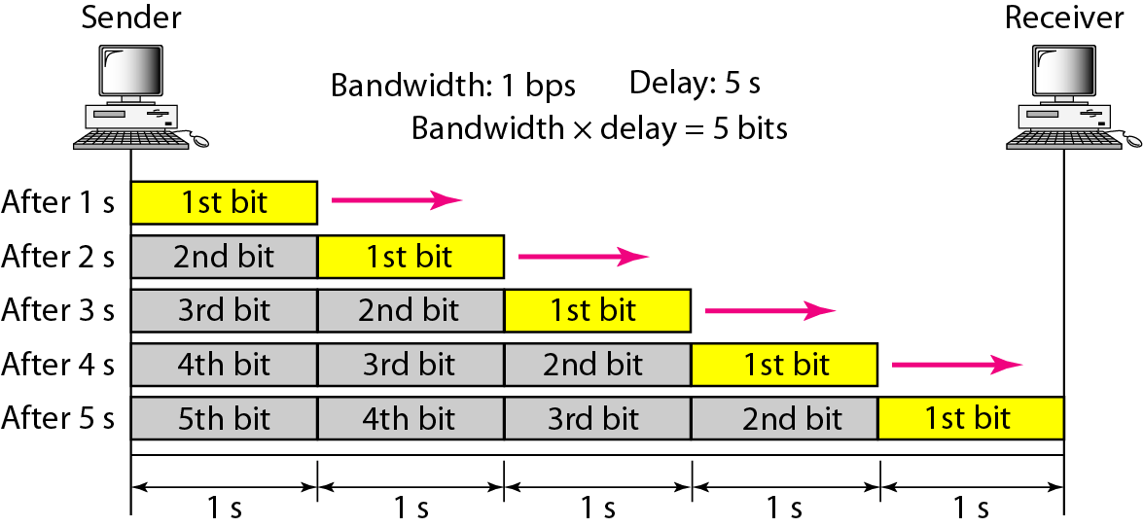
Figure 3.32 Filling the link with bits for case 1

Slide 119
Example 3.48
We can think about the link between two points as a pipe. The cross section of the pipe represents the bandwidth, and the length of the pipe represents the delay. We can say the volume of the pipe defines the bandwidth-delay product, as shown in Figure 3.33.

Slide 120
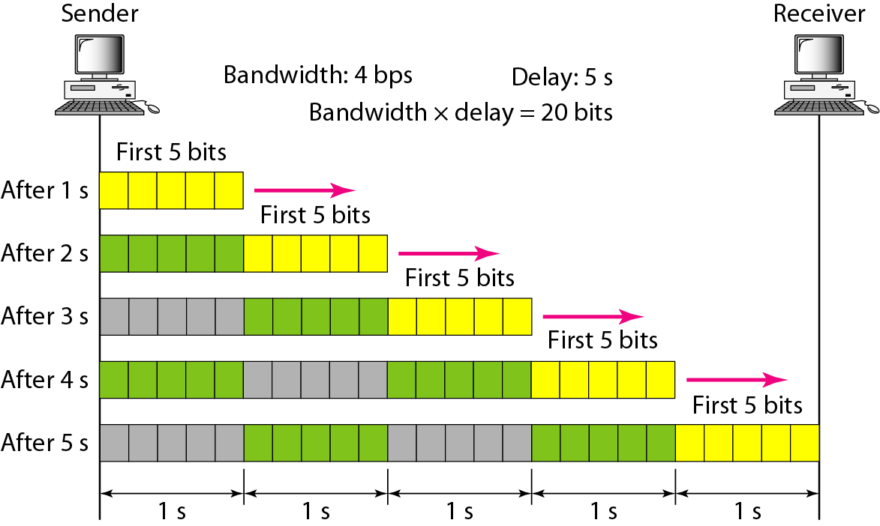
Figure 3.33 Filling the link with bits in case 2

Slide 121
Note
The bandwidth-delay product defines the number of bits that can fill the link.

Slide 122

Figure 3.34 Concept of bandwidth-delay product

